Slide 1
Unix
Introduction to the vi Editor

Slide 2

Module Objectives
After completing this module you will be able to:
Explain why vi is important
Create and edit files using vi
Execute commands within vi
Customise the vi environment

Slide 3
What is vi?
vi is a visual text editor included by default in all Unix operating systems.
vi has six basic modes of operation, but we will concentrate on the following:
Normal mode - this is the default mode when vi is first opened. Keystrokes are evaluated as commands and not as text entered in the file you are editing.
Insert mode - in this mode, keystrokes enter characters into the file you are editing.
Command-line mode - has a wide variety of commands and can do things that Normal mode can’t do as easily.
To move from Normal mode to Insert mode, press i, a or o
To move from Insert mode to Normal mode, press Esc
To move from Normal mode to Command-line mode, press :
Notes:
Vim has six basic modes;
Normal
Visual
Select
Insert
Command-line
Ex-mode.

Slide 4
vi or vim?
vim is short for 'vi improved'. It takes vi as its base and adds numerous features.
In the Linux system we are using, both vi and vim are symbolic links to the same application (vim.basic), so it doesn't matter whether you use vi or vim to invoke the editor.
For simplicity, we will continue to refer to the editor as vi in these slides.

Slide 5
Insert Mode
Although most users switch to Insert mode by pressing i or a, there are several more ways:
i – Moves to insert mode
I – Moves to insert mode (insert at start of line)
a – Moves to insert mode
A – Moves to insert mode (append at end of line)
o – Moves to insert mode (opens up a new line below cursor)
O – Moves to insert mode (opens up a new line above cursor)

Slide 6
Normal Mode
To switch to Normal mode, press the Esc key
Necessary for text modifications, navigation, cut and paste etc.
There are a large number of commands available - almost all the keys are programmed to do something.
Consult the cheat sheet for a full listing.

Slide 7
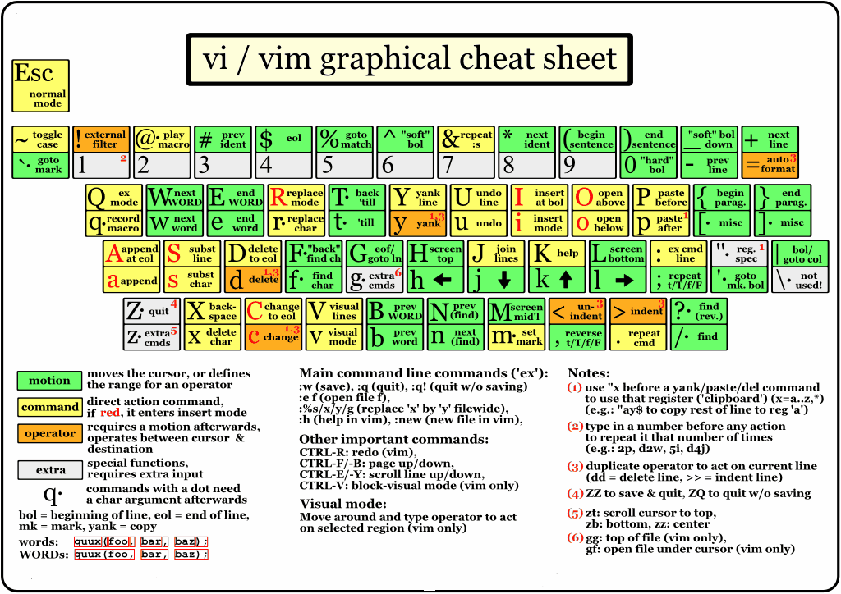

Slide 8
Normal/Command-line Mode - Navigation
Cursor keys will probably work, but some Unix environments don't recognise these keys, so use h j k and l instead:
h =ç j = ê k = é l = è
:1 - Go to the first line of the file
G - Go to the end of the file
:n - Go to the nth line of the file
} - Move the cursor to the end of the paragraph
{ - Move the cursor to the beginning of the paragraph
H - Go to first line on the screen
L - Go to the last line on the screen
M - Go to the middle line on the screen
^ or 0 - Go to start of the line
$ - Go to end of the line

Slide 9
Deleting
x – Delete a character
nx – Delete n characters (where n is any number)
dw – Delete a word
ndw – Delete n words
dd – Delete a line
ndd – Delete n lines

Slide 10
Copy, Cut & Paste
v - Mark text to be copied/cut (character by character)
V - Mark text to be copied/cut (line by line)
y - Copy marked text
x - Cut marked text
yy - Copy the current line
nyy - Copy n lines into the buffer (where n is any number)
nY - Same as above
p - Paste cut/copied text after the cursor
P - Paste cut/copied text before the cursor

Slide 11
Other Common Commands
r - Replace single character
R - Overtype mode (press Esc to come out of it)
. - Repeat the previous command
u - Undo
Ctrl+r - Redo
/xxxx - Forward search for xxxx (from current position to end of file)
?xxxx - Reverse search for xxxx (from current position to beginning of file)

Slide 12
Saving Your Work
:w - Write out data from the buffer to a file (Save)
:wq - Write out data and exit (Save and Quit)
:x - Write out data and exit (same as previous)
ZZ - Write out data and exit (same as previous)
:q - Quit editor (as long as no changes have been made)
:q! - Quit, abandoning any changes
ZQ - Quit, abandoning any changes (same as previous)
:w filename - Write a copy out to a new file name (Save As...)
:w! - Force write (ignores file permissions provided you own the file)

Slide 13
More Advanced Commands
Examples of commands in Command-line mode to alter the user environment:
:set all - Show all parameters that you can set
:set nu - Turn line numbers on
:set nonu - Turn line numbers off
:set cursorline - Display a line under the cursor position
:set nocursorline - Turn off the cursor line
:set mouse=a - Enable mouse for scrolling and resizing
:set mouse=r - Disable mouse for scrolling and resizing
:set tabstop=n - Set the tab to indent n spaces (default is 8)

Slide 14
More Advanced Commands
Examples of commands in Command-line mode to edit existing text:
:31,51d - Delete lines 31-51
:20,$d - Delete all lines from line 20 to the end of the file
:%s/xxxx/yyyy - Substitute (%s) the first instance of xxxx on each line with yyyy
:%s/xxxx/yyyy/g - Substitute (%s) all instances of xxxx with yyyy globally (g)
The default separator in Command-line mode is the forward slash (/), but you can use any non-alphanumeric character (except \, " or |):
:%s#bin/touch#bin/ls#g - Substitute every instance of bin/touch with bin/ls
Note: vi has a command history - to access it, type a colon (:) and then use the up and down cursor keys, or Ctrl+f to display the command history window. (Ctrl+c twice to close it)

Slide 15
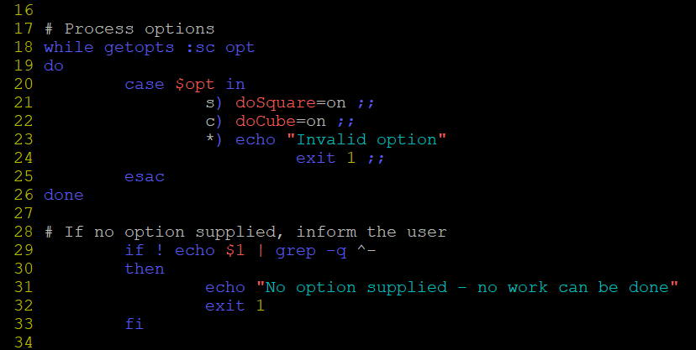
Syntax Highlighting
By default, when editing script files for example, vi highlights different script elements (variables, commands, comments etc.) in different colours.
Some users find these colours distracting or hard to read:
You can turn syntax highlighting off with the following command:
:syntax off

Slide 16
The .vimrc File
The .vimrc (vim Runtime Configuration) file is a text file that contains optional settings to initialize vi/vim when it starts.
You can create a .vimrc file in your home directory and put suitable commands in it that will run every time you open vi/vim.
Example .vimrc file content:
set nu
set tabstop=4
set mouse=a
syntax off
The above settings will turn on line numbers, set the tab stop to 4 spaces, enable mouse scrolling and turn off syntax highlighting. Note that the colon (:) is not required.

Slide 17
Module Objectives
After completing this module you should be able to:
Explain why vi is important
Create and edit files using vi
Execute commands within vi
Customise the vi environment

Slide 18
Questions

